Slide 1


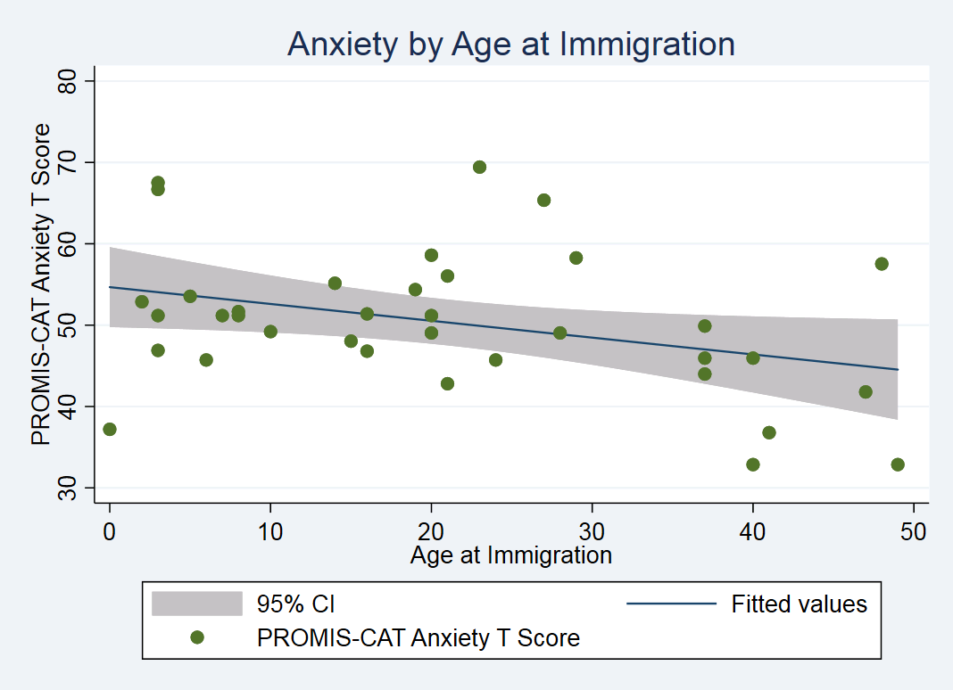
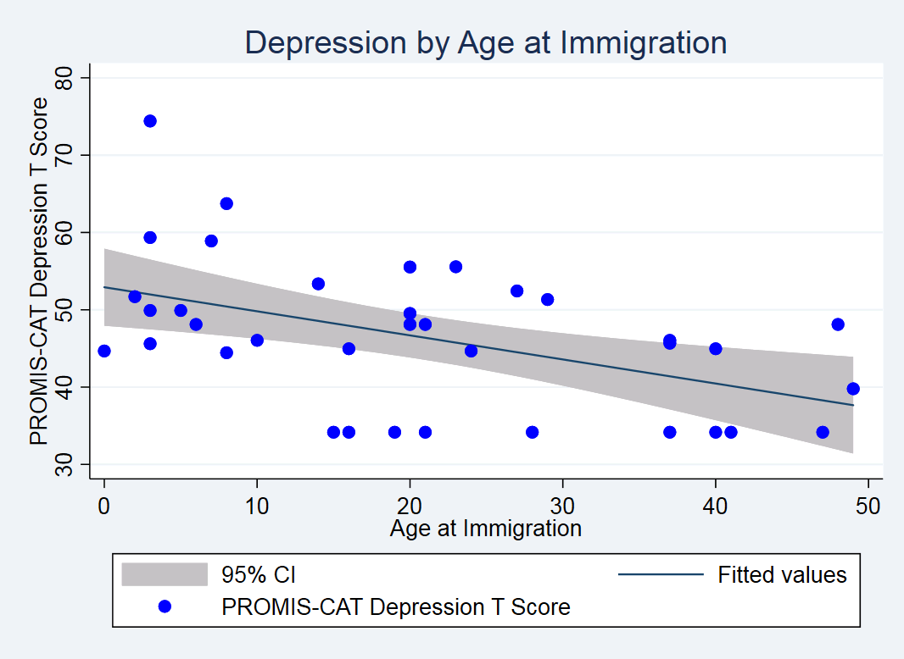
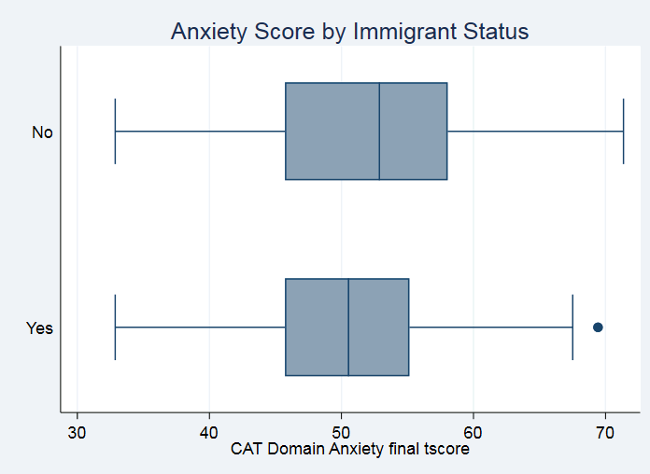
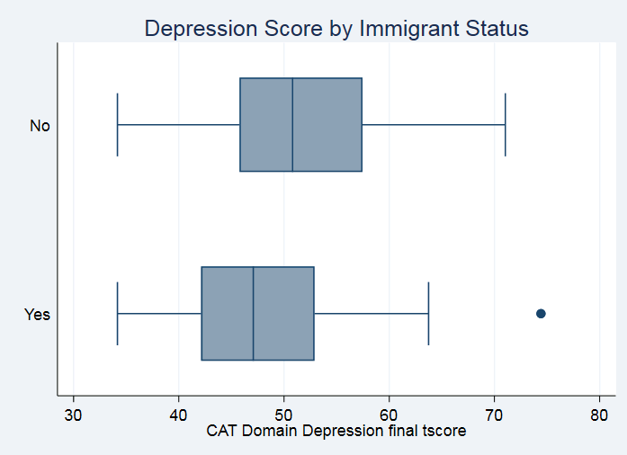
Anxiety and depression in immigrant liver transplant recipients
Eric Mauti^{1,2}, Karthik Mohan¹, Jasleen Gill¹, Rabail Siddiqui¹, Setareh Aghamohammadi¹,
Junayd Hussain¹, Mohammed Saqib¹, Evan Tang¹, Marta Novak¹, Nazia Selzner¹, Istvan Mucsi¹
¹ University Health Network, Multi-Organ Transplant Program and Division of Nephrology, Toronto, Canada
² Faculty of Medicine, University of Toronto, Toronto, Canada
Background
Objective
Figure 2 – Anxiety and Depression by Age at Immigration
~1 in 5 Canadians are immigrants (born outside of Canada).
Immigrant status may be associated with higher anxiety and depression vs non-immigrants due to stressors associated with immigration.
Chronic liver disease is frequent among immigrants, in part due to higher prevalence of hepatitis B and C infection.
Liver transplant (LT) is the only definitive treatment for liver failure.
Immigrant LT recipients (LTRs) may have greater anxiety and depression than non-immigrant LTRs.
The objective was to assess if immigrant status is associated with self-reported anxiety and depression among LTRs.
p=0.037*
p=0.003*
Table 1 – Population Demographics
Variable | Total Cohort | Non-Immigrant | Immigrant | p-value
Sample size (n) | 145 (100%) | 104 (71%) | 41 (28%)
Mean age (±SD) | 56 (15) | 53 (15) | 62 (11) | 0.003*
Gender – Male | 101 (70%) | 70 (67%) | 31 (76%) | 0.231
Median years since transplant (IQR) | 5.4 (1-12) | 5.0 (1-12) | 7.0 (2-12) | 0.562
Ethnicity – White | 97 (67%) | 80 (77%) | 17 (41%) | <0.001*
Education – <12 years | 48 (33%) | 39 (38%) | 9 (22%) | 0.075
English as First Language – Native | 98 (68%) | 90 (87%) | 8 (20%) | <0.001*
Employment Status – Employed | 70 (48%) | 49 (47%) | 21 (51%) | 0.710
Income – <30k | 19 (9%) | 16 (15%) | 3 (7%) | 0.435
Methods
A cross-sectional cohort of adult prevalent LTRs from a single Canadian transplant centre completed the PROMIS CAT Anxiety and Depression item banks through electronic data capture.
Immigration status, sociodemographics, and clinical variables were also collected.
Independent samples t-test was used to compare anxiety and depression scores between immigrants and non-immigrants.
Information about age at immigration, years in Canada, and immigration method were also considered.
Table 2 –– Multivariable Linear Regressions for Anxiety and Depression by Age at Immigration
Outcome | Model | Results
 |  | b | CI | P-value
Anxiety | 1 | -0.2 | -0.4 to 0 | 0.037*
 | 2 | -0.2 | -0.4 to 0 | 0.064_
Depression | 1 | -0.3 | -0.5 to -0.1 | 0.003*
 | 2 | -0.3 | -0.5 to -0.1 | 0.005*
Model 1: Univariable analysis Model 2: Model 1 + age, sex
Results
Mean(SD) age of 145 participants was 56(15) years, 70% male, 67% White, 28% immigrant [Table 1].
Immigrants vs non-immigrants, had lower depression and similar anxiety scores. [Figure 1].
Upon multivariable adjustment, anxiety and depression scores were similar between groups (b[95%CI] 1.0[-2.6–4.6]; -2.5[–6.0–1.0).
Mean(SD) time since immigration was 38(17) years, and mean(SD) age at immigration was 21(15) years. Most immigrants (90%) were landed immigrants.
Older age at immigration was associated with lower anxiety and depression scores following univariable analysis [Figure 2] [Table 1]
When adjusted for age and sex, older age at immigration was associated with a lower depression score (-0.3[-0.5–-0.1], p=0.005) [Table 2].
Discussion and Conclusion
Figure 1 – Anxiety and Depression by Immigrant Status
Immigrant status was not associated with anxiety or depression among LTRs.
Immigrants who immigrated at an older age had lower depression scores.
Individuals in this group may have greater personal and economic stability at the time of immigration.
This may result in fewer immigration stressors, potentially leading to lower self-reported depression scores.
Selective immigration policies, favouring healthy and educated immigrants, could also influence this relationship.
Additionally, immigrants who immigrate at an older age may maintain greater cultural ties as a result of decreased assimilation. This could reflect the observed lower depression scores.
p=0.362
p=0.010*

